Slide 1
A trip to England
Городской фестиваль открытых уроков «Эффективный урок»
Подготовили: Афанасьева Ксения Александровна, учитель английского языка Егорова Наталья Александровна, наставник
с. Нагорье 2023

Slide 2
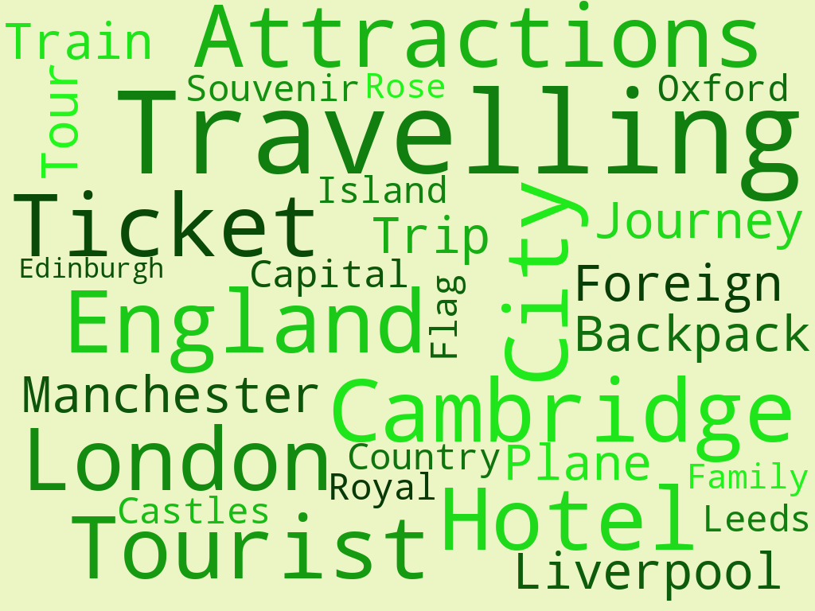

Slide 3
A trip to England

Slide 4
Match city names and facts about them.
Manchester
Oxford
Stratford-upon-Avon
Brighton
The birthplace of William Shakespeare
Has a well-known football team
Well-known place for international meetings
Has the world’s oldest museum and a world famous university

Slide 5
“Travel to England”
We advise you to visit England – the historical centre of Great Britain! We can offer you comfortable buses, detailed maps, the most … places of interest and the best guides. If you want to travel with professionals, choose us. We are the most experienced travel agency in Britain. We provide full information about … festivals, … concerts, … exhibitions and … sporting events. We can help you to plan a … trip that you will want to remember forever.
musical
thrilling
popular
traditional
famous
fantastic

Slide 7
“Travel to England”
We advise you to visit England – the historical centre of Great Britain! We can offer you comfortable buses, detailed maps, the most popular places of interest and the best guides. If you want to travel with professionals, choose us. We are the most experienced travel agency in Britain. We provide full information about traditional festivals, musical concerts, famous exhibitions and thrilling sporting events. We can help you to plan a fantastic trip that you will want to remember forever.

Slide 8
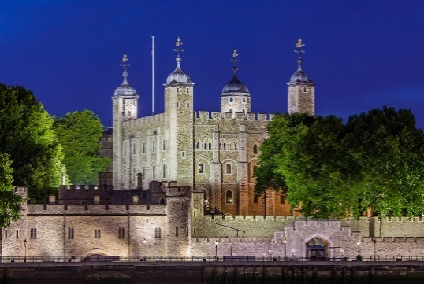
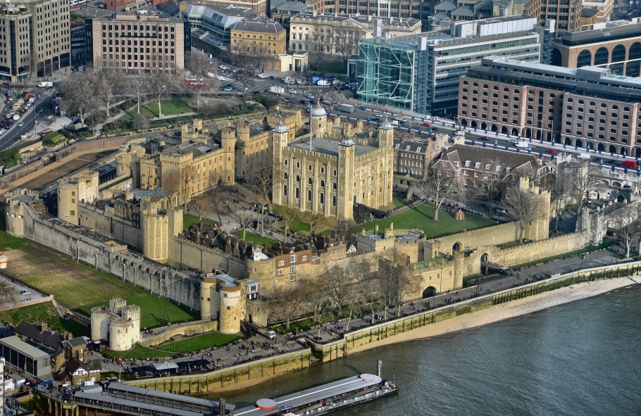
Tower of London
This tower was once a palace, a fortress, a prison and even a ZOO

Slide 9
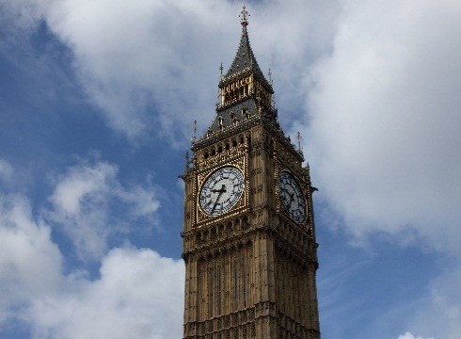
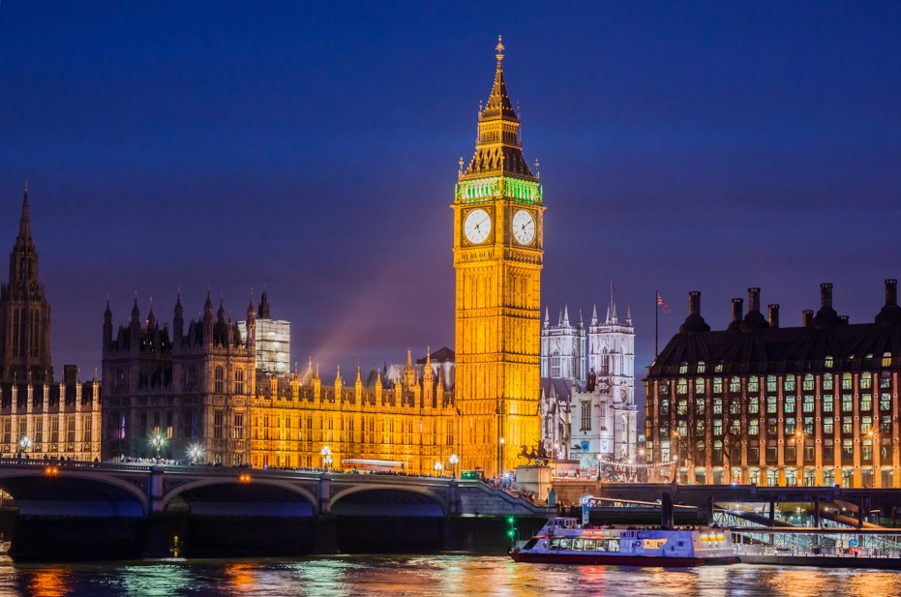
Big Ben
It is a big bell, which you can hear every hour

Slide 10
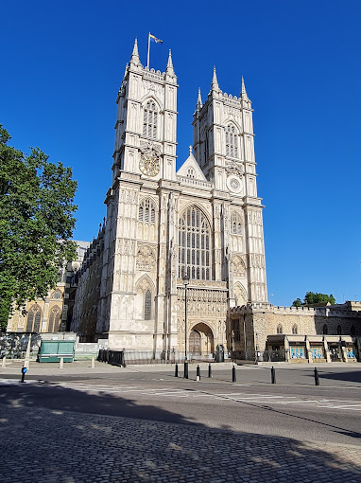
Westminster Abbey
It is a famous Anglican church in the City of Westminster

Slide 11
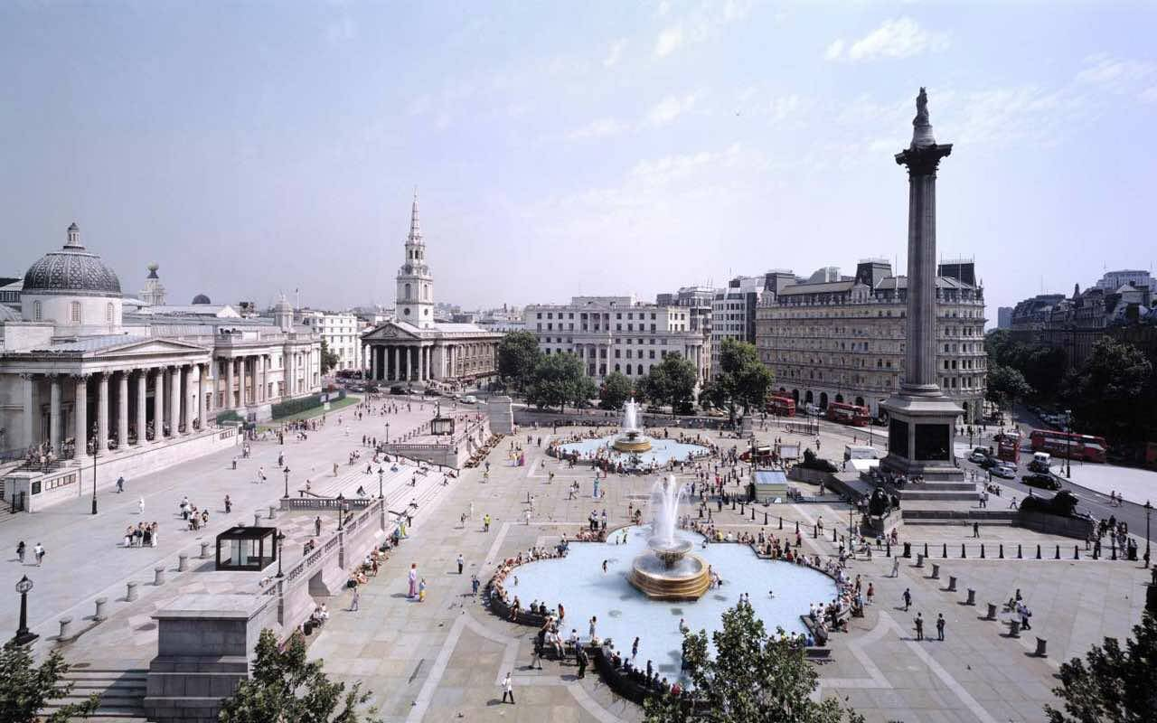
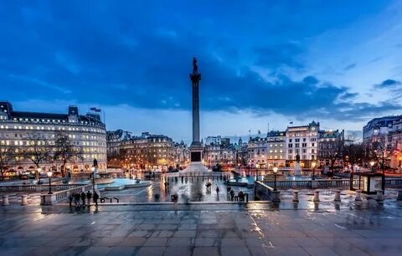
Trafalgar Square
It is a public square that features some of London’s top attractions

Slide 12
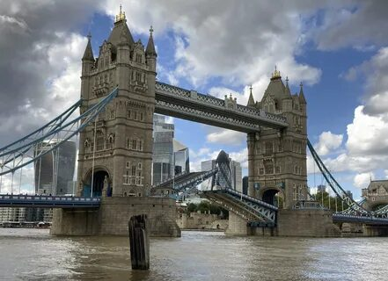
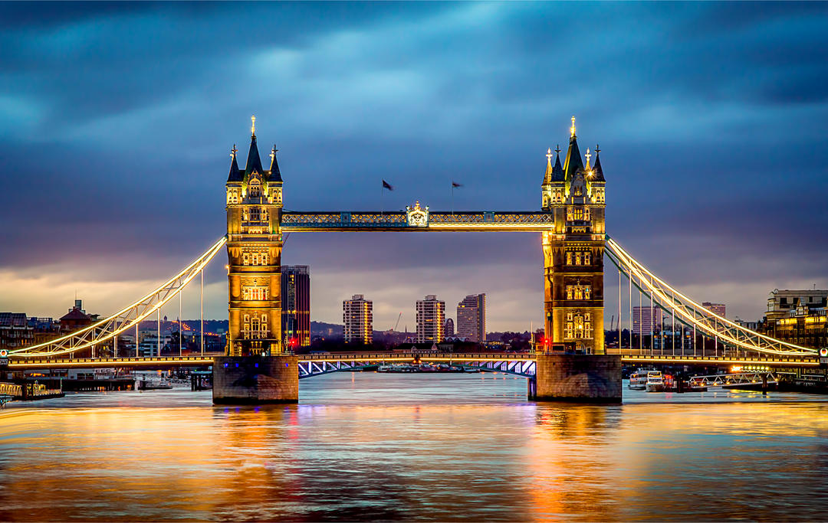
Tower Bridge
It is a bridge, that crosses the river Thames

Slide 13
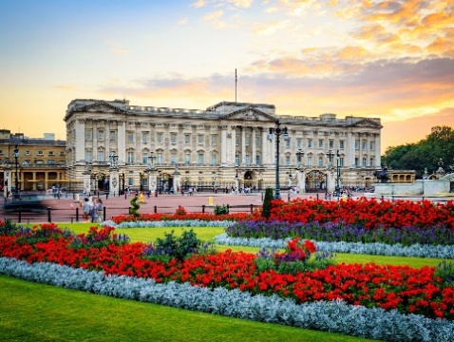
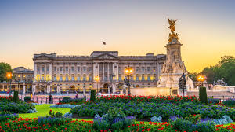
Buckingham Palace
This palace is the official London residence of the British monarch

Slide 14
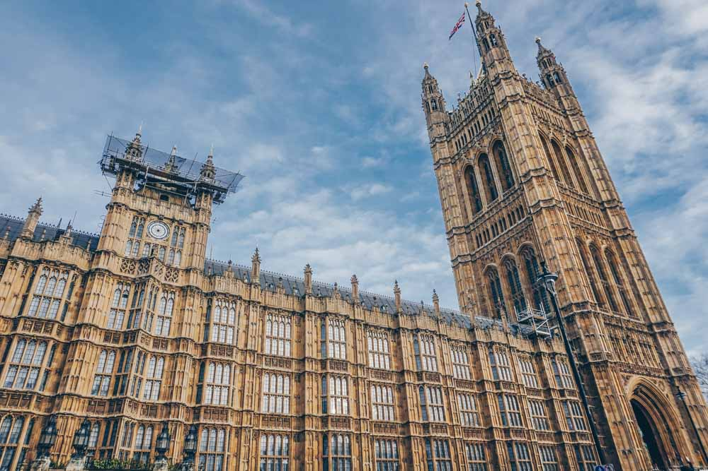
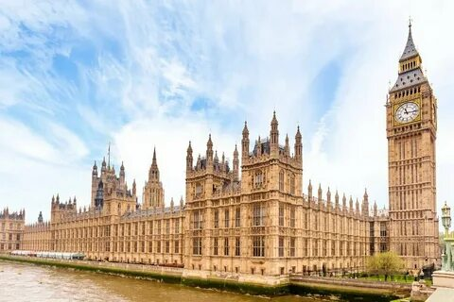
The Houses of Parliament
This building combine the House of Commons and House of Lords

Slide 15
