Slide 1
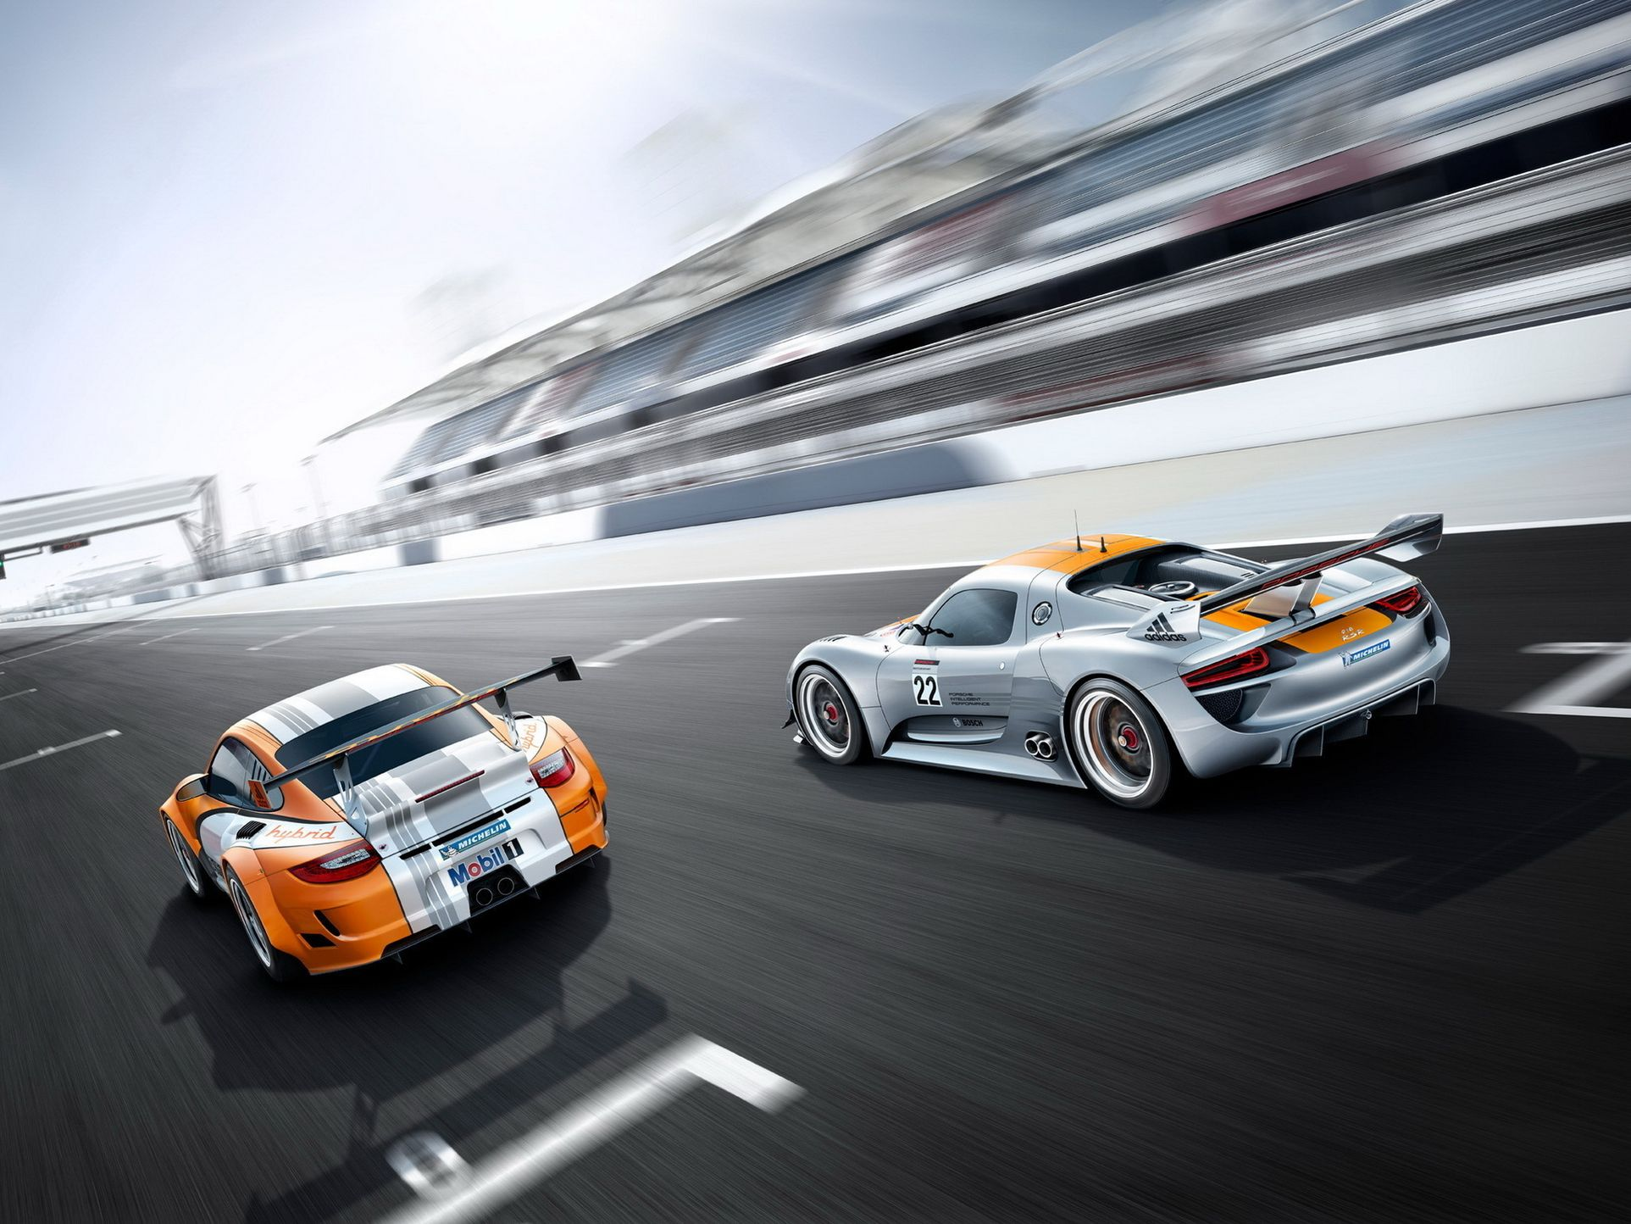
Hot wheels

Slide 2
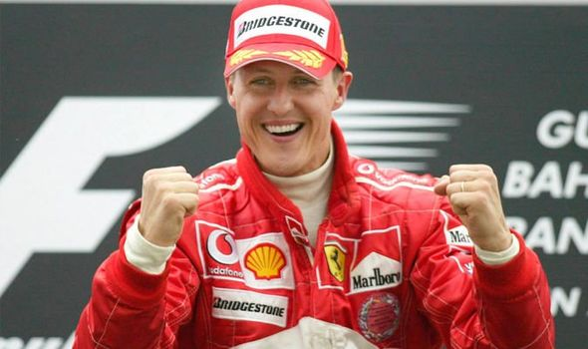
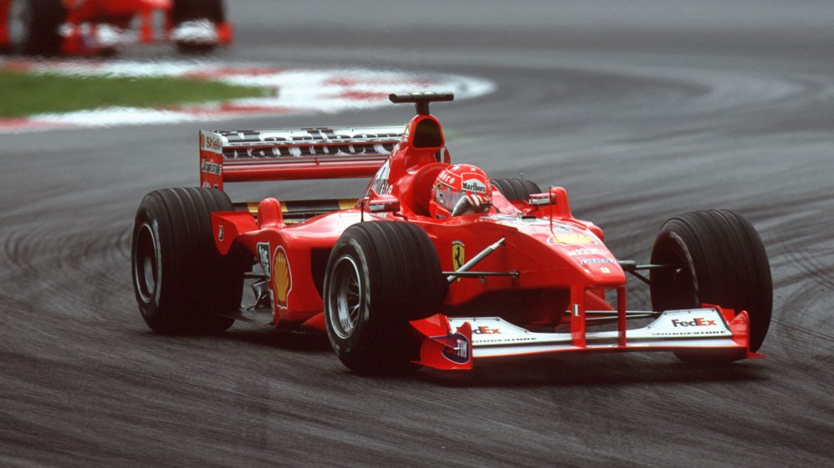
Michael Schumacher
1. Schumacher’s nickname is Schumi
2. He comes from Germany
3 His hobbies are football and
tennis

Slide 3
Occupation: racing car driver
Team: Ferrari
Born: 3ld January, 1969
Personal details: rather tall and thin
with short
dark hair

Slide 4
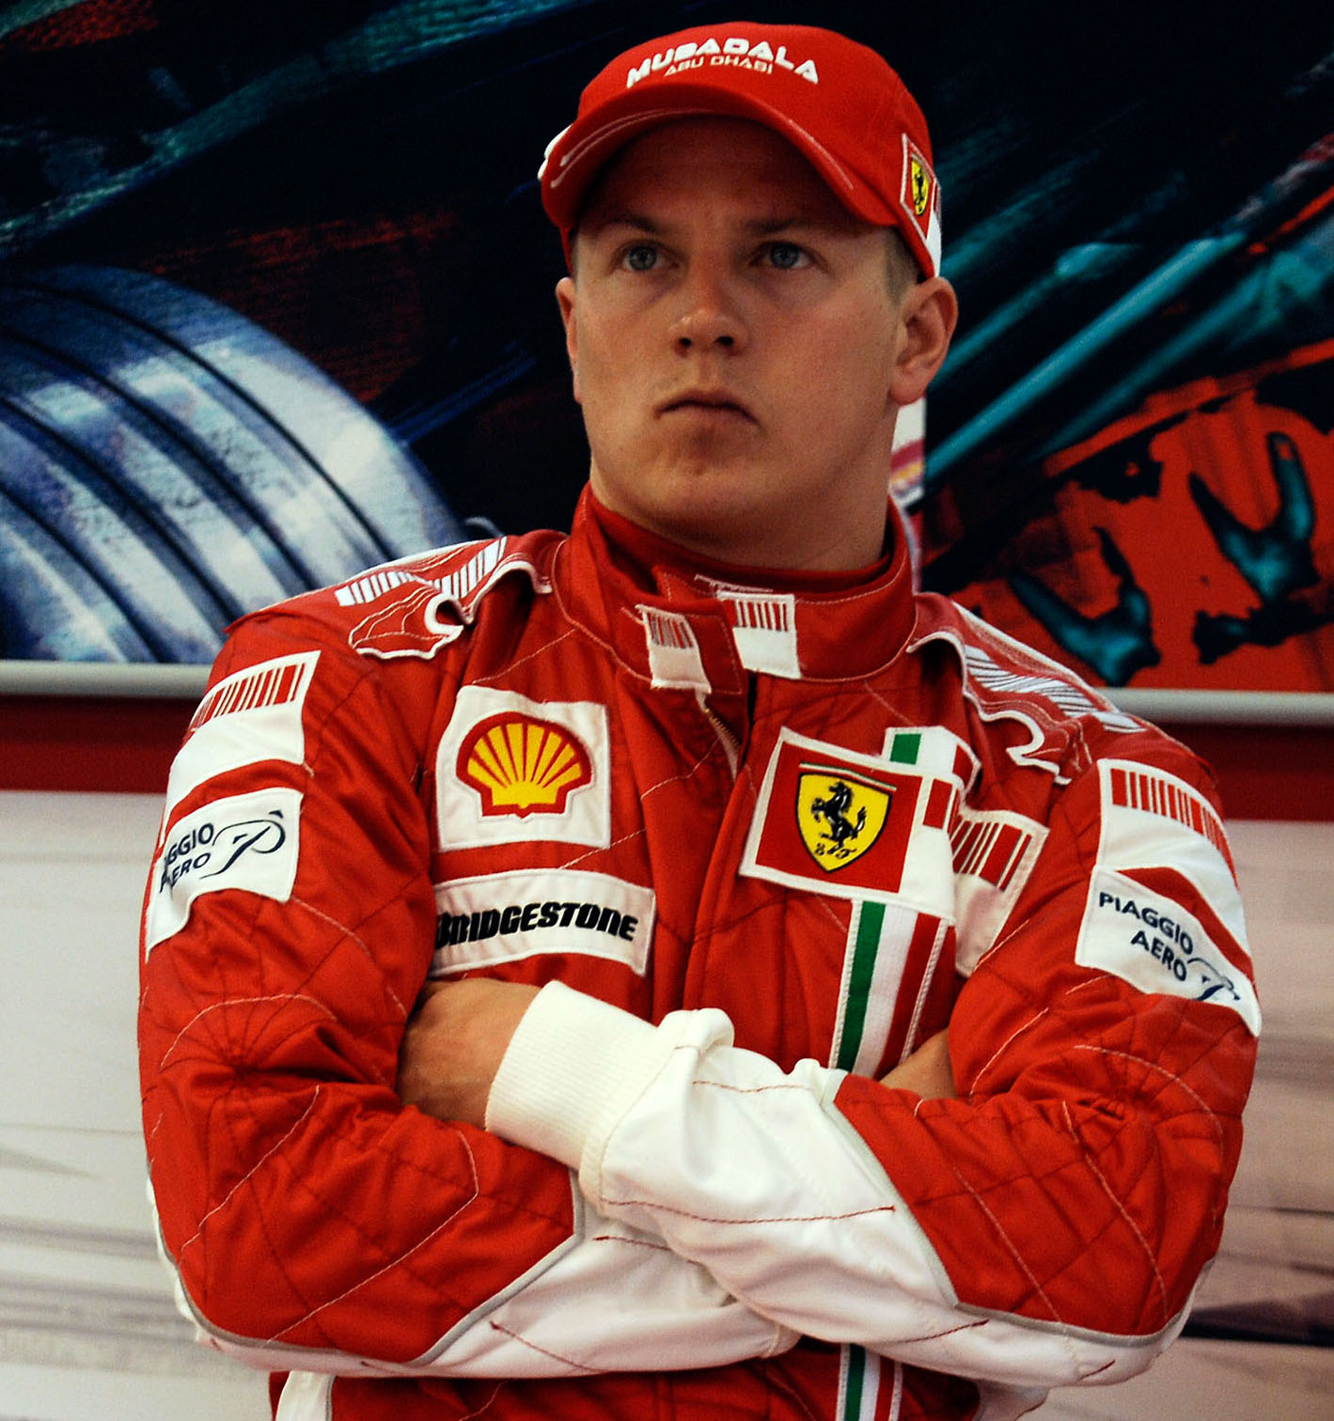
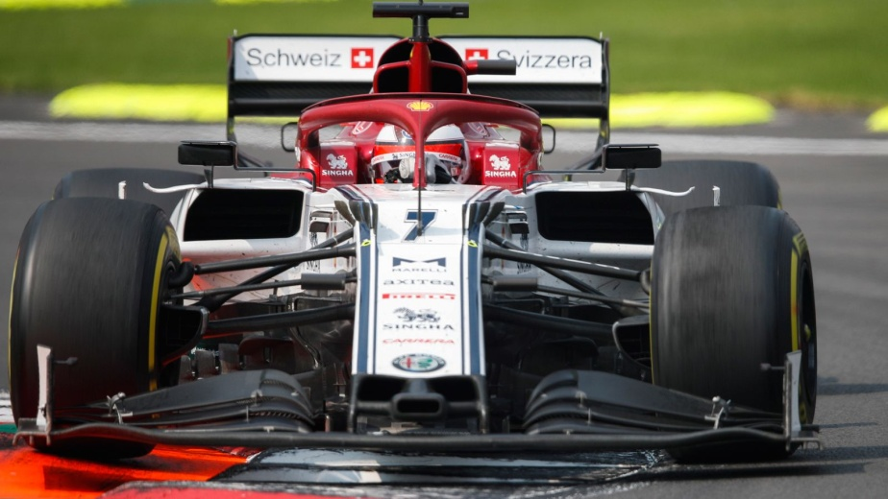
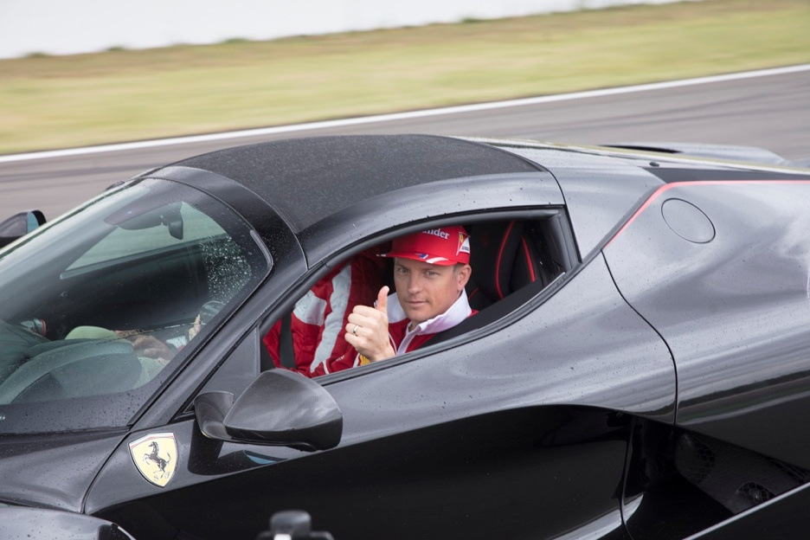
Kimi Raikkonen

Slide 5
NAME: Kimi
SURNAME: Raikkonen
NICKNAME: Iceman
OCCUРATION: Racing
car driver
NATIONALITY: Finnish
BORN: 17th October, 1979
РERSONAL DETAILS: short blond hair
HOBBIES: Snowboarding, jogging, ice hockey

