Slide 1
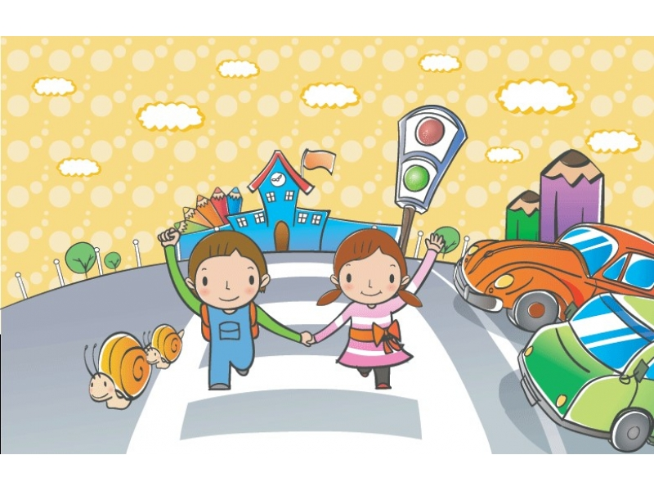
Road safety

Slide 2
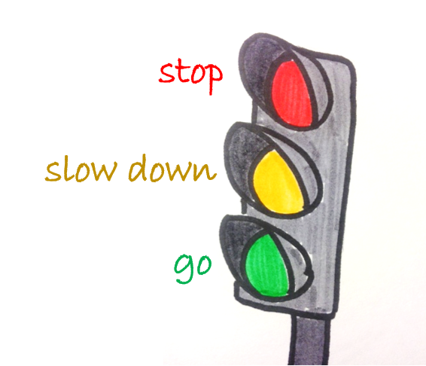
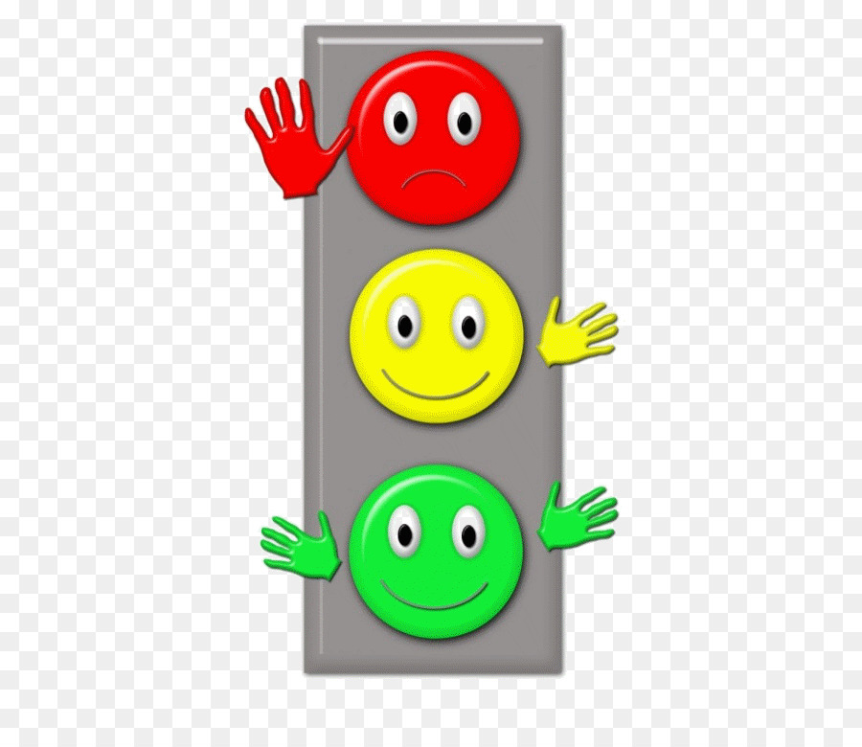
Traffic lights
One of a set of red, yellow, and green lights that control the movement of vehicles

Slide 3
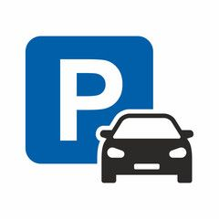
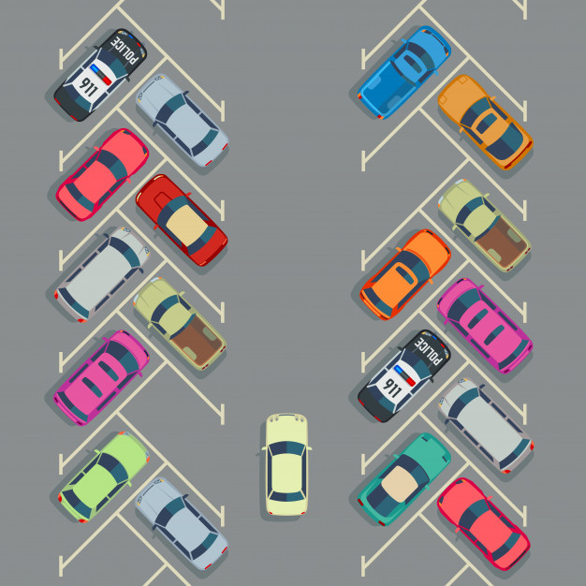
Parking zone
A place where you can park a car

Slide 4
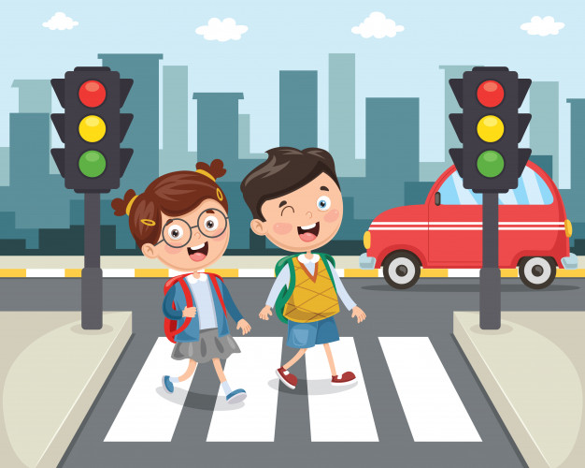
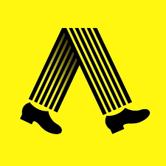
Pedestrian
A person who is on foot, not by car/ bike

Slide 5
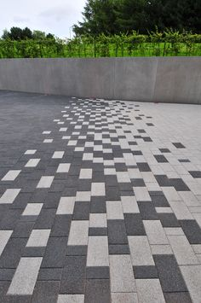
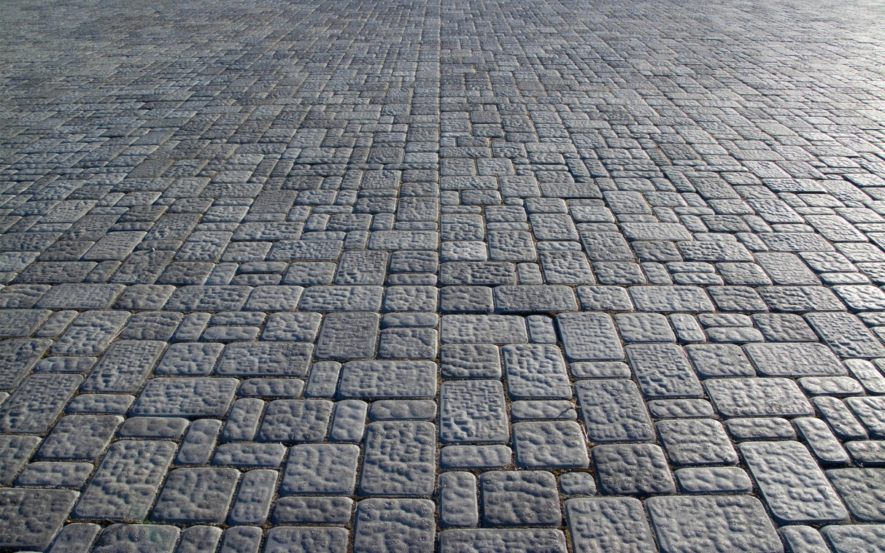
Pavement
An area which people use for walking

Slide 6
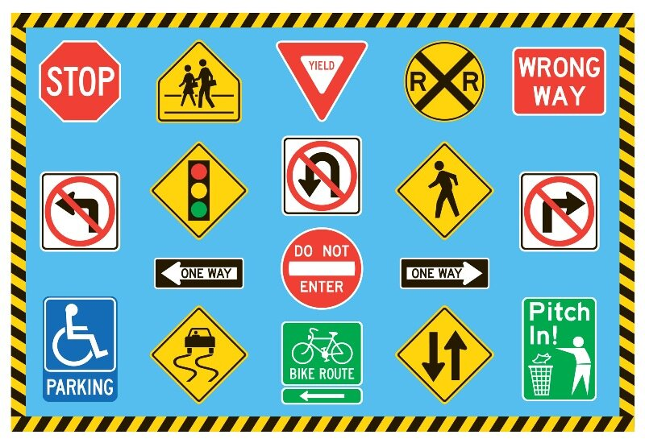
Traffic sign
A sign on the road

Slide 7
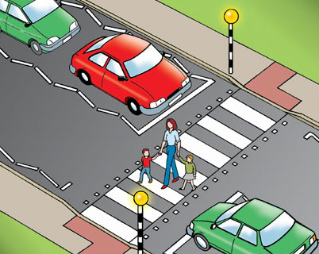
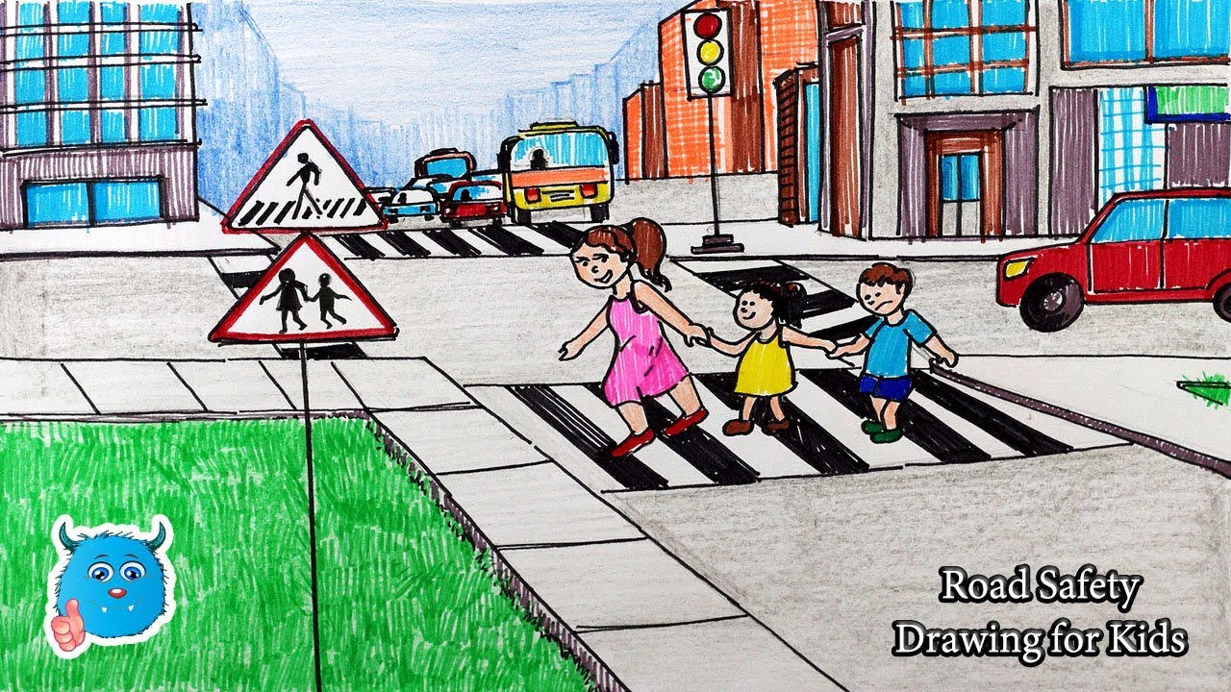
Zebra crossing
White stripes on the road. People can cross the road on it

Slide 8
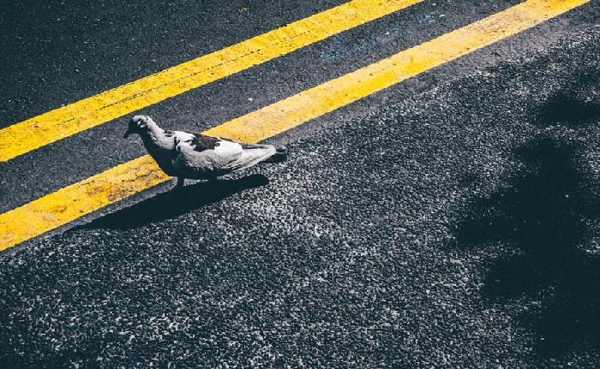
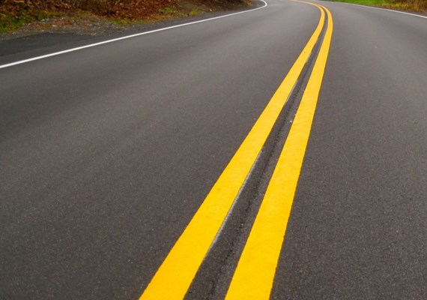
Yellow lines
Two solid yellow lines mean no passing

Slide 9
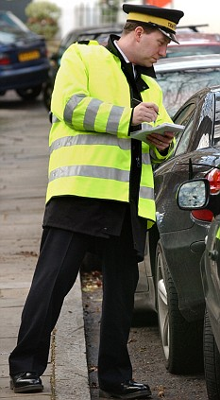
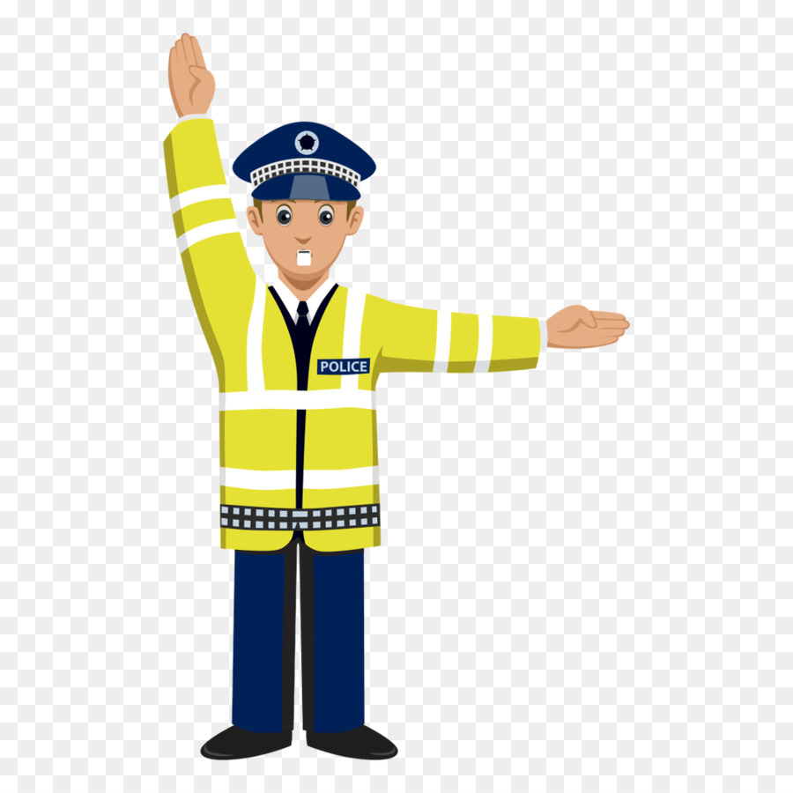
Traffic warden
A name of a job. This person watches the traffic and makes it safe

Slide 10
Exercise 2 | Answers
1.Wear | G. a seat belt
2.Walk straight | F. across the road
3.Look | E. both ways
4.Run onto | D. the road
5.Talk to | C. the driver
6.Walk on | B. the pavement
7.Lean out of | A. the window

Slide 11
Safe | Dangerous
It’s safe to wear a seat belt | It’s dangerous to walk straight across the road
It’s safe to look both ways before crossing the road | It’s dangerous to talk to the driver
It’s safe to walk on the pavement | It’s dangerous to lean out of the window

Slide 12
Exercise 3b | Answers
When on the street | don’t talk to the driver don’t lean out of the window
When in the car | look both ways before crossing don’t run onto the road
When on bus | wear a seat belt sit in the back if you are under 12

Slide 13
Exercise 4 The words in bolt
Cross - пересекать
Parked - припаркованный
Stand on – стоять на
Pavement - тротуар
Kerb - бордюр
Traffic – движение
Working condition – рабочее состояние
Flow - поток
Lanes - переулки
Bright - яркий
Annoy - раздражать

Slide 14
Exercise 5
window
tyres
bus
seats
driver
bicycle
lanes
bike
handgrips
helmet
rearview
handles
car
seatbelt
mirror
seat

Slide 15
Exercise 7
1. On foot
2. By car/bus/train/plane/bike
3. On a bus
4. In the 8 o’clock train

