Slide 1
United Kingdom
holidays

Slide 2
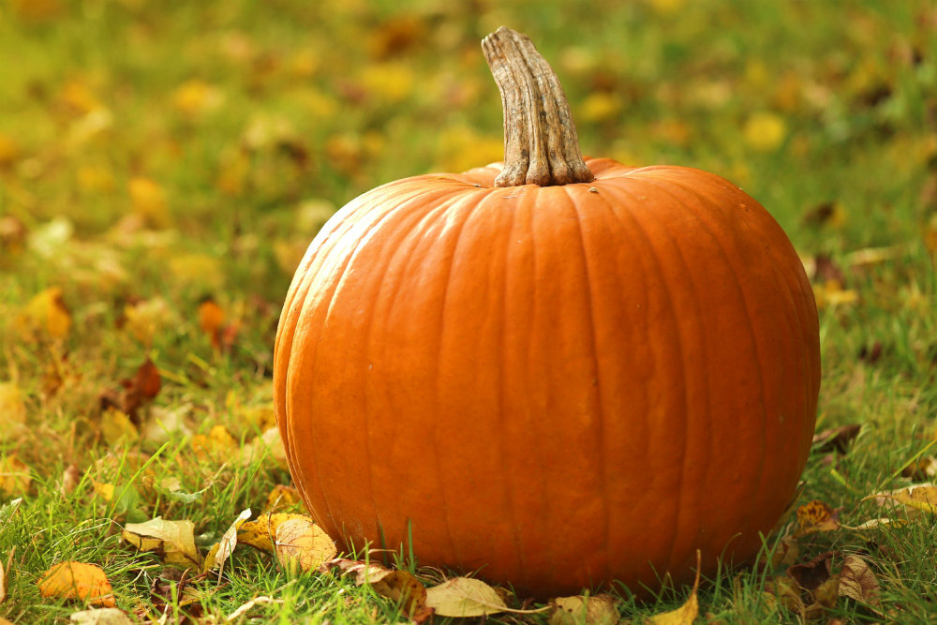
Pumpkin

Slide 3
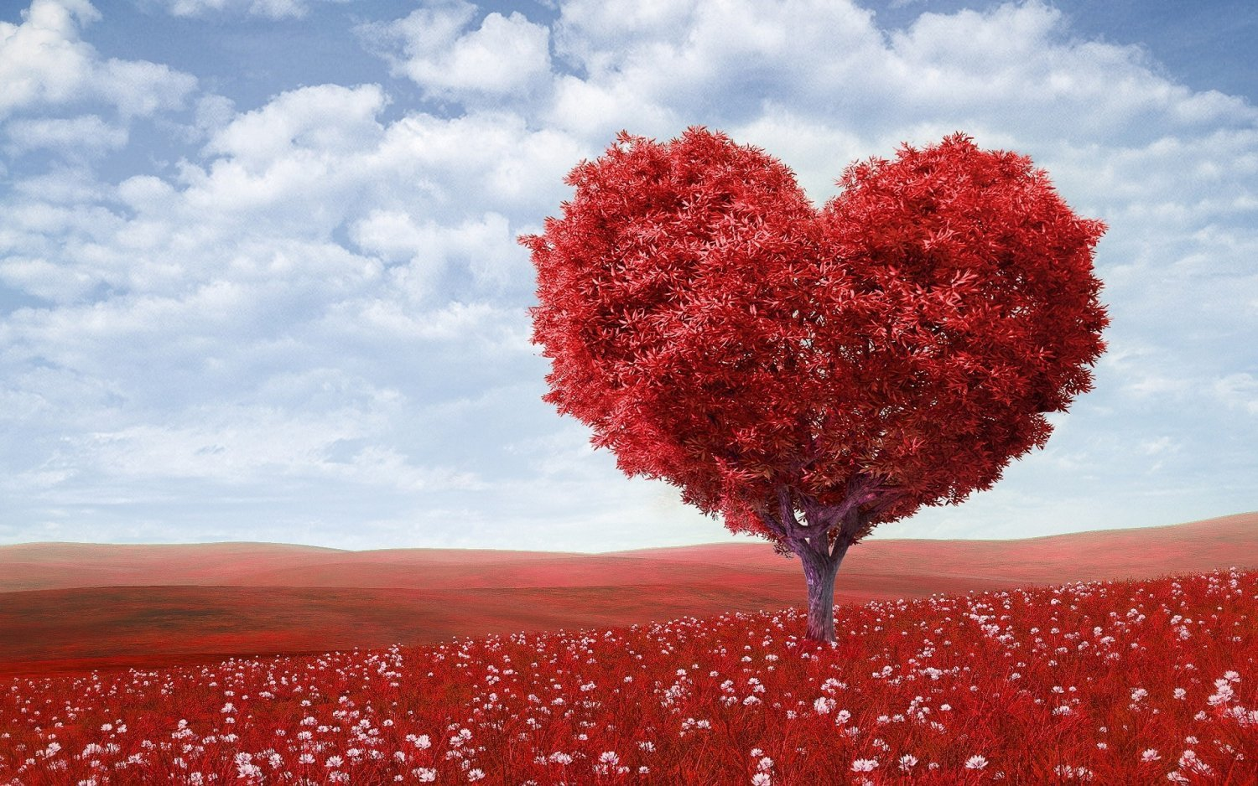
St. Valentine’s day

Slide 4
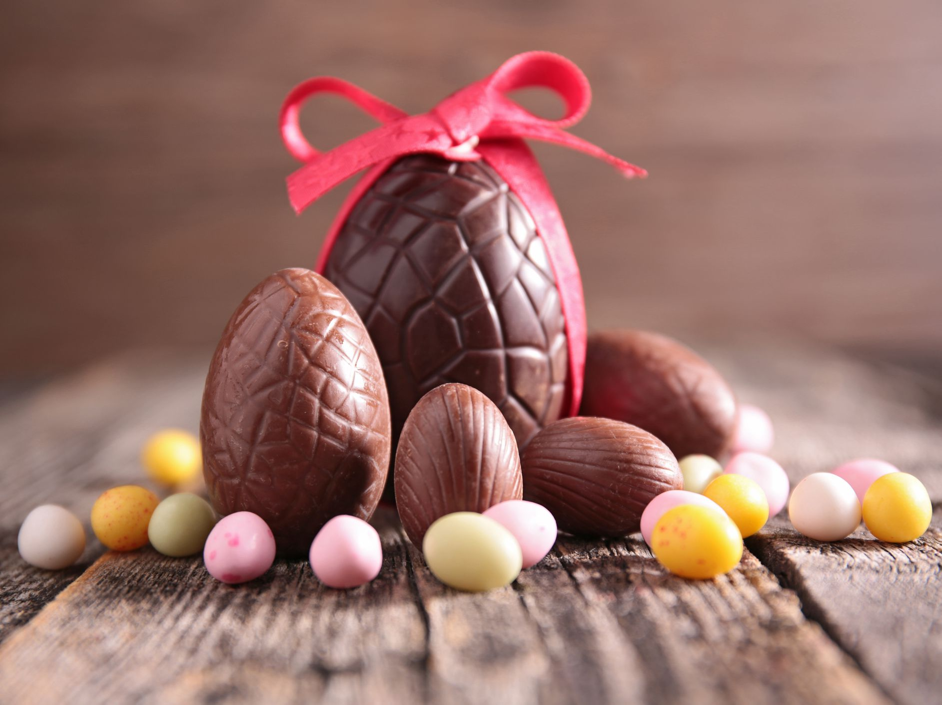
Chocolate eggs

Slide 5
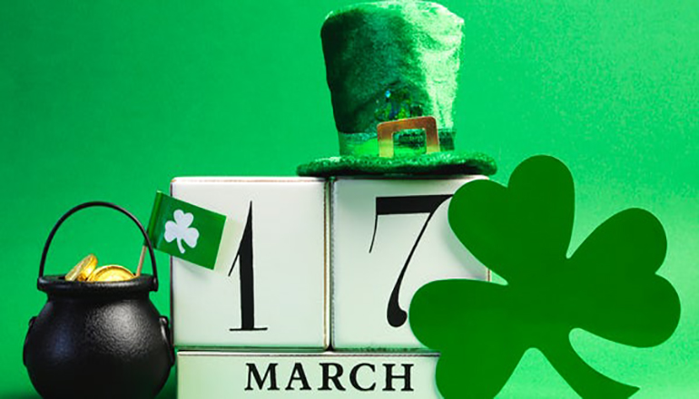
St. Patrick day

Slide 6
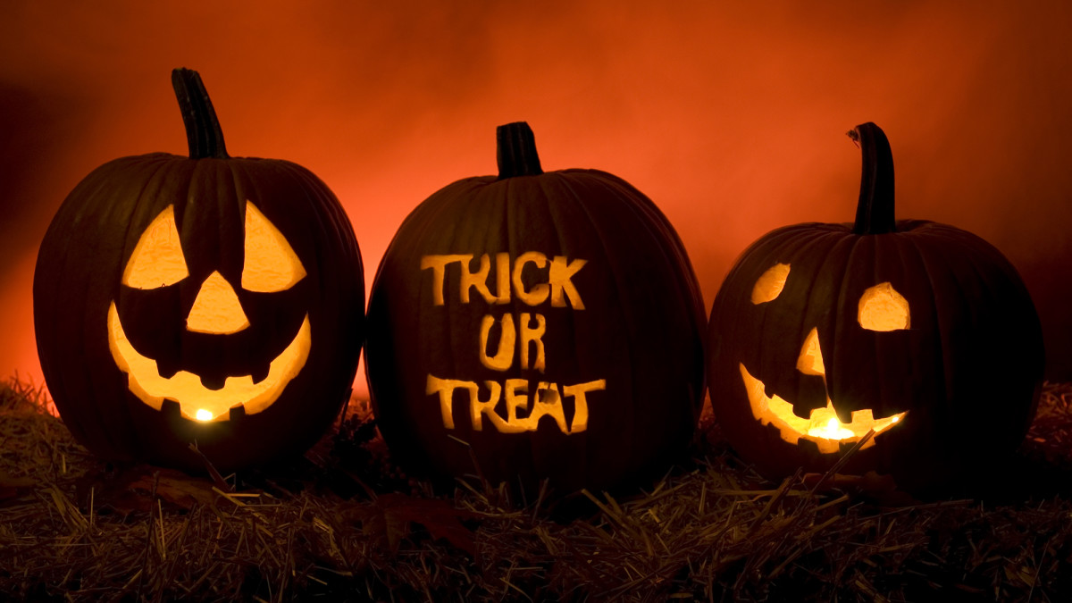
Halloween

Slide 7
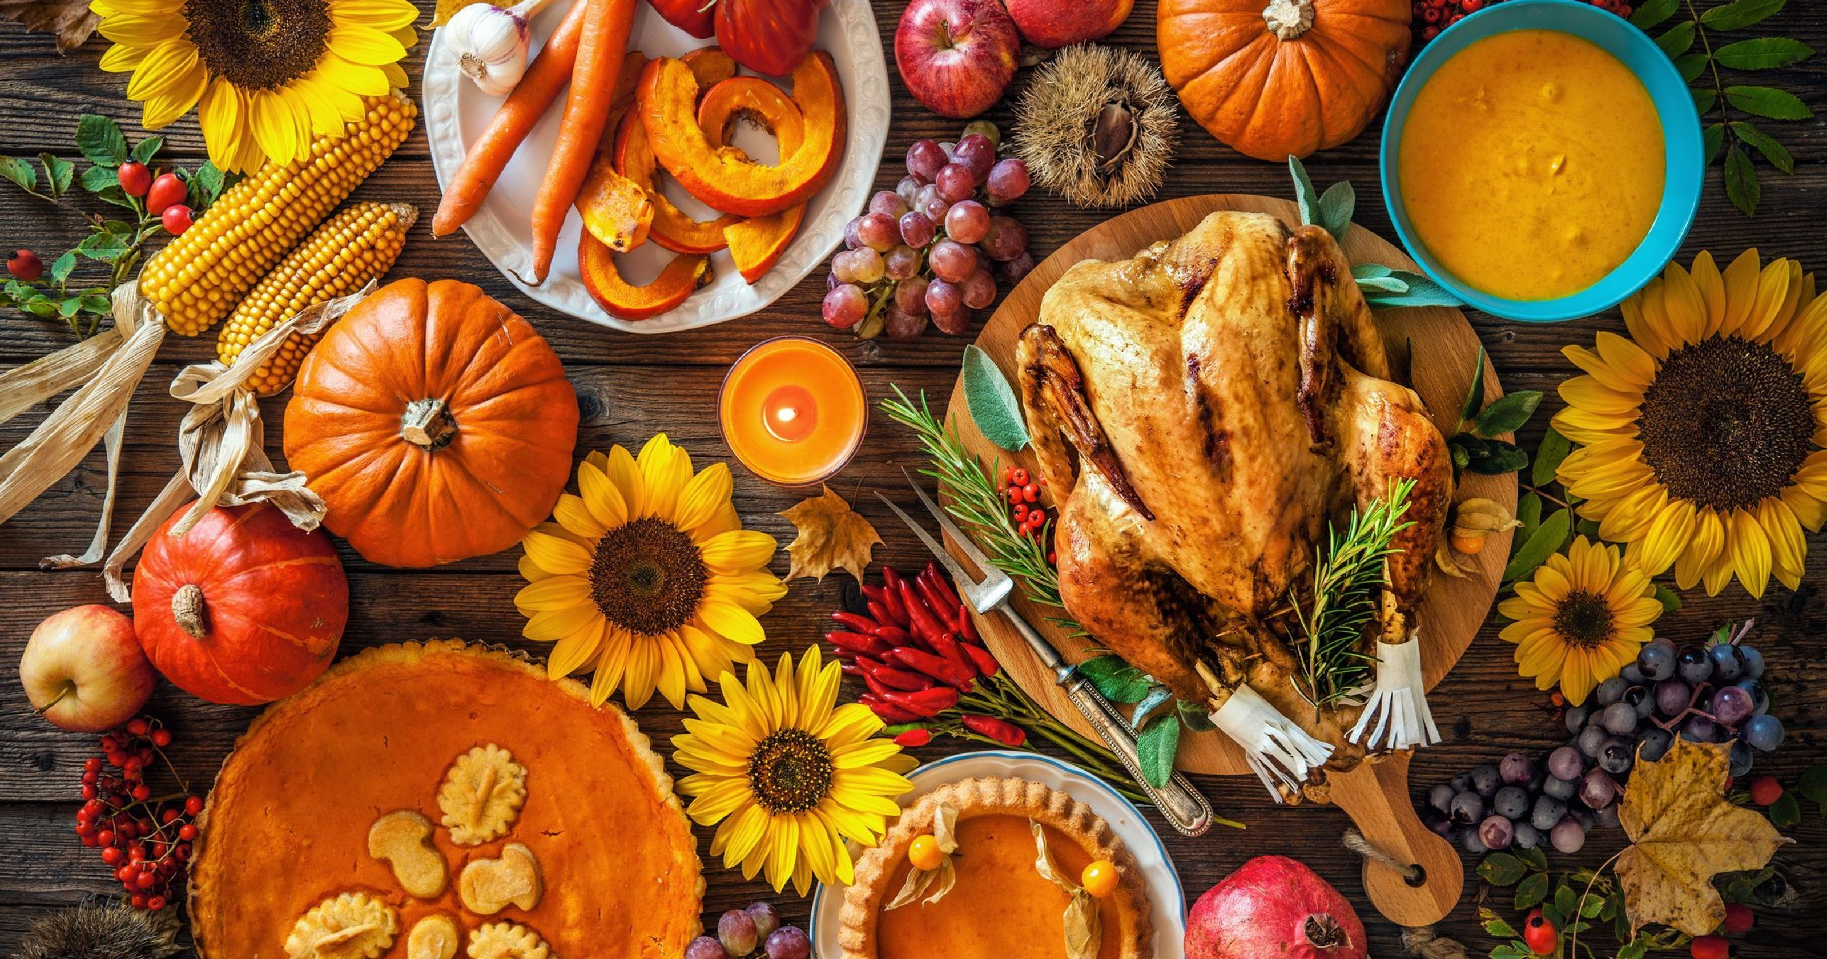
Thanksgiving day

Slide 8
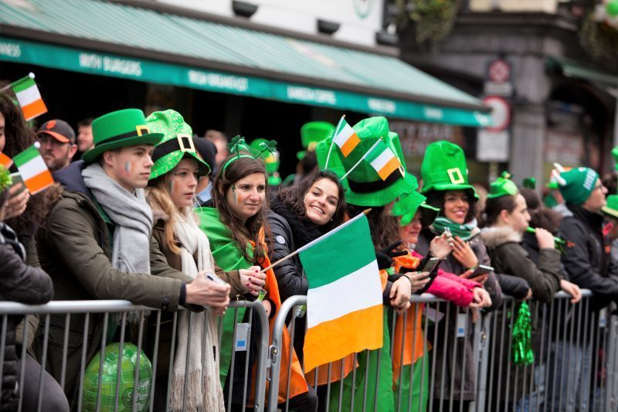
Ireland

Slide 9
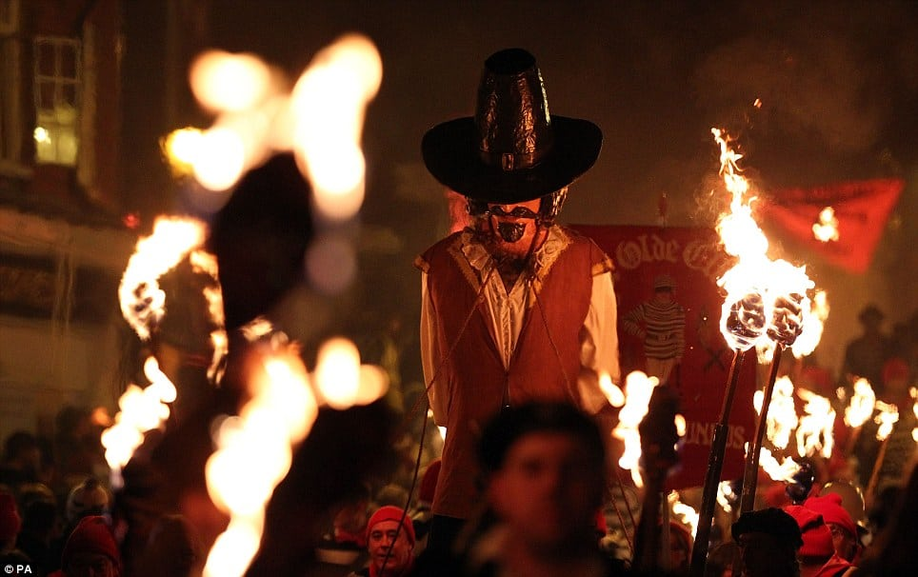
Guy Fawkes day

Slide 10
Make the correct words and give a translation
1.yalpisd
2. iveseft
3.ekam keca a
4.eat emka
5.Roksrefiw
6.etefof elpap
7.gnigivsnkhaT ayd
8.esocumt
9.enitlenVa ‘s ayd
10.erathw

Slide 11
Captains competition
I may not always tell you What I'm feeling deep _________ (inside, in gate, in front of you) The emotions and the _________ (darling, feelings, Thanksgivings) That I sometimes tend to hide But I'm really proud and pleased To know that you are _________ (yours, theirs, mine) And I hope that you still _______ me (don’t love, love, hate) My ___________ Valentine (Darling, festive, important)

Slide 12
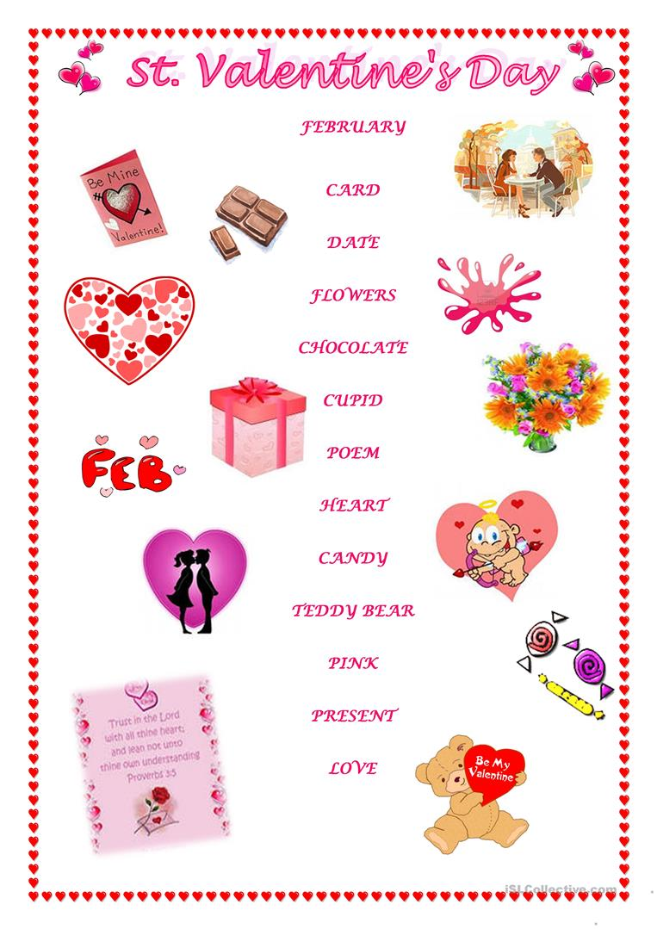
Match words with pictures

Slide 13
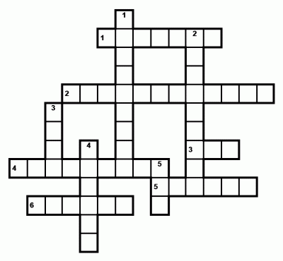
Crossword

Slide 14
Down:
………'s Day is on the 14th of February. People make or buy cards and send them to the people they love.
……… is on the 25th of December. Presents for children are in their stockings.
April ………'s Day is on the 1st of April. Children play tricks on other people and have a lot of fun.
………'s Day is in March. It is a holiday for English women.
……… Year's Day is on the 31st of December. Some people in England have parties on that day.

Slide 15
Across:
St. ………'s Day is a national holiday in Ireland. It is on the 17th of March.
……… Day is in November. People in America eat roast turkey and pumpkin pie.
……… Day holiday is on the first Monday in May.
……… is on the 31st of October. Children go from house to house and say "Trick or treat".
……… Day is in April or at the end of March. Children get chocolate eggs or rabbits on that day.
………'s day is in June. It is a holiday for English men.

